Slide 1
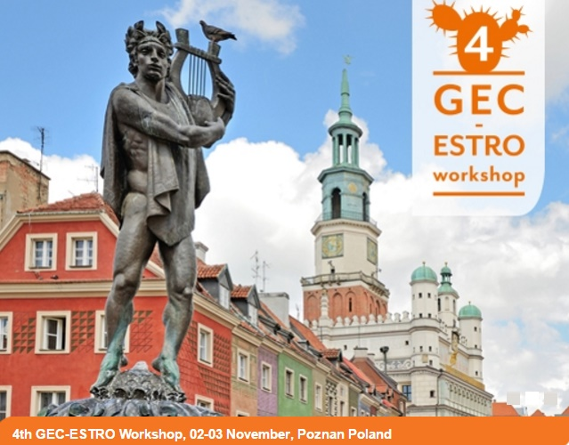
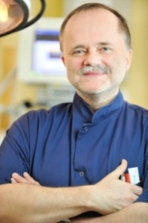
Prostate trials – past and the future
Prof. Janusz Skowronek, MD, PhD,
Brachytherapy Department, Greater Poland Cancer Centre,
Electroradiology Department, University of Medical Sciences, Poznan, Poland
www.wco.pl/zb

Slide 2
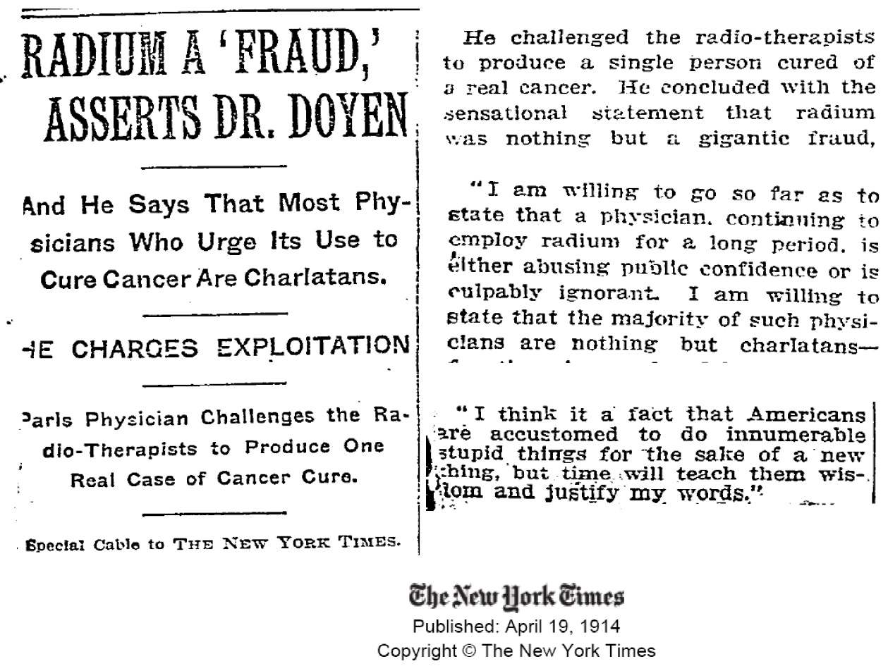
Radium? – no way….

Slide 3
Prostate cancer - treatment
Surgery
Radiotherapy
Nerve Sparing Prostatectomy – 1998
Prostatectomy
Laparoscopic – 2000
Prostatectomy
Robotic - 2003
Ig-TRUS LDR Seeds – 1987
IG-IMBT HDR – 1991
EBRT 3D- conformal – 1992
EBRT A-IGRT – 1996
EBRT Intensity Modulated
- 1999

Slide 4
Radiotherapy
External Beam Radiation Therapy (EBRT)
Brachytherapy (BT)
EBRT 2D
Conformal EBRT 3D
EBRT IMRT
EBRT IGRT
Tomotherapy
Cyberknife
Protons
BT HDR (High-Dose–Rate)
BT LDR (Low-Dose-Rate)
BT ultra LDR (seeds)
BT PDR (Pulsed-Dose-Rate)
+/-
Hiperthermia

Slide 5
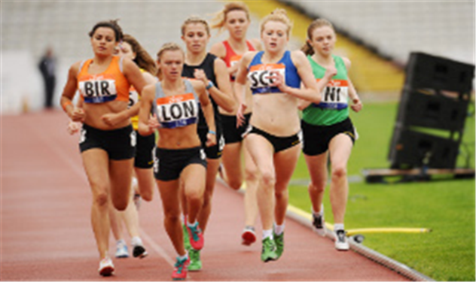
Physician, patients choice
Prostatectomy
*simple
*nerve sparing
*laparoscopy
*robotic (Da Vinci)
Brachytherapy:
*ultraLDR (seeds)
*HDR
*PDR
+/- hyperthermy
*HIFU
*Criotherapy
*Nanoknife
*Hormontherapy
*Chemiotherapy
*Watchful Waiting
*Active Surveillance
EBRT:
* 3D
*IMRT
*Hypofractionation
*IGRT
*Tomotherapy
*Cyberknife
*Protons
Results
QoL
Costs

Slide 6
Results – not possible to compare?
From:
„Comparing Treatment Results Of PROSTATE CANCER”
Prostate Cancer Results Study Group 2016
Peter Grimm, DO
Prostate Cancer Center of Seattle

Slide 7
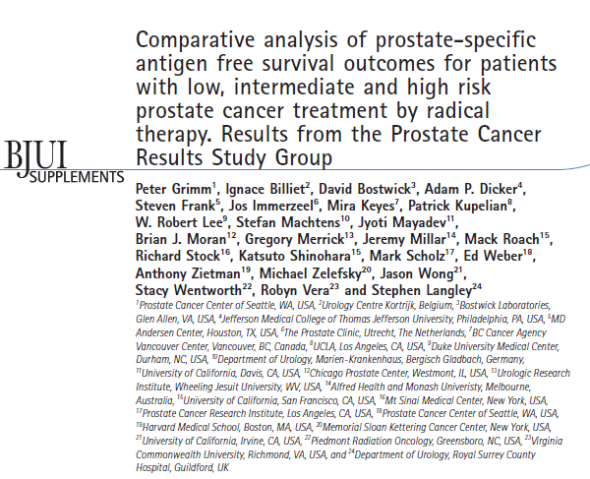
BJU International 2012; 109, supplement 1, 22–29

Slide 8
What ’ s known on the subject? and What does the study add?
Very few comparative studies to date evaluate the results of treatment options for prostate cancer using the most sensitive measurement tools.
PSA has been identified as the most sensitive tool for measuring treatment effectiveness.
To date, comprehensive unbiased reviews of all the current literature are limited for prostate cancer.
This is the first large scale comprehensive review of the literature comparing risk stratified patients by treatment option and with long-term follow-up.
The results of the studies are weighted, respecting the impact of larger studies on overall results.
The study identified a lack of uniformity in reporting results amongst institutions and centres.

Slide 9
The role of brachytherapy should be considered
for most men with localized prostate cancer
• Outcomes probably better than with other local treatments
• Consider adding EBRT and/or ADT for higher risk disease
• Seeds or HDR brachytherapy?
Conclusions
44.900+ prostate studies were published between 2000 and 2015.
1.415 of those studies featured treatment results.
208 of those met the criteria to be included in this review study.
Some treatment methods are under-represented due to failure to meet criteria.
Comparing Treatment Results of PROSTATE CANCER
Prostate Cancer Results Study Group - June 2016

Slide 10
Treatment Symbols Ledger- for all risk groups graphs
Brachytherapy
Brachytherapy alone
Brachytherapy & EBRT
Brachytherapy, EBRT, & ADT
HDR (Brachytherapy)
HDR & ADT (Brachytherapy)
EBRT/IMRT
EBRT alone
EBRT & ADT
Hypo EBRT
Protons
Protons
Surgery
RP Surgery
Robotic Surgery
RP Surgery & EBRT
Cryotherapy
Cryotherapy
HIFU
HIFU

Slide 17
Summary evidence prostate cancer
Low Risk
BT is as effective as EBRT or RPE (or AS >65 y)
different morbidity/PRO profiles
Intermediate Risk
BT*+EBRT** (BT alone) at least as effective as
EBRT alone** or RPE
different morbidity/PRO profiles
High Risk
BT*+EBRT** superior to RPE or EBRT alone**
*I-125 LDR or Ir 192 HDR BT
**Hormonal treatment, as indicated, is not considered here

Slide 18
ASTRO 2016 Bradley Prestidge, Past – President ABS, Bon Secours Cancer Institute at DePaul Medical Center in Norfolk, Virginia
Phase III Trial
Brachytherapy alone can control intermediate-risk prostate cancer
579 patients (median age – 67 years), intermediate-risk , T1c (67%) - T2b, Gleason score – 2 - 6, PSA 10 ng/ml – 20 ng/ml, or Gleason score 7 and PSA < 10 (89%),
Group I - BT only – 292 patients, I-125 or Pd-103, 146 Gy,
Group II – Combined treatment – 287 patients (EBRT 45 Gy) + I-125 or Pd-103, 110 Gy,
Follow-up (median) – 6.7 years,
PFS – Group I – 86%, 5 years follow-up,
Group II - 85%, 5 years follow-up, p = 0.0006

Slide 19
ASTRO 2016 Bradley Prestidge, Past – President ABS, Bon Secours Cancer Institute at DePaul Medical Center in Norfolk, Virginia
The addition of external beam therapy to brachytherapy did not significantly extend PFS among men with intermediate-risk prostate cancer
Additionally – lower complication rate in the group I
“This means men with intermediate-risk prostate cancer may be quite well managed with brachytherapy alone” - Prestidge

Slide 20
ASCENDE‐RT trial Morris WJ, Tyldesley S, Pai HH, et al. A multicenter, randomized trial of dose-escalated external beam radiation therapy (EBRT-B) versus low-dose-rate brachytherapy (LDR-B) for men with unfavorable-risk localized prostate cancer. BC Cancer Agency: Vancouver, Vancouver Island, Southern Interior, and Fraser Valley Centers, BC Sunnybrook Cancer Centre, Princess Margaret Hospital, Toronto, Ontario
ASCENDE-RT
Androgen Suppression Combined with Elective Nodal and Dose Escalated Radiation Therapy
ASCENDE‐RT trial is the first and only existing randomized comparison of low‐dose‐rate prostate brachytherapy (LDR‐PB) for prostate cancer with any other method of curative radiation therapy.
Results presented on 2015 ASCO Annual Meeting and ABS 2015

Slide 21
ASCENDE‐RT trial
Learning objectives
• To be aware of first reported RTC of dose escalated EBRT vs. LDR prostate boost (“triple therapy”) in High-Tier Intermediate and High Risk pCa
• To describe:
– Clinical and PSA outcomes
– Incidence and prevalence of late GU and GI toxicity in
this population

Slide 22
ASCENDE‐RT trial

Slide 23
ASCENDE‐RT trial

Slide 24
ASCENDE‐RT trial

Slide 25
ASCENDE‐RT trial

Slide 26
ASCENDE‐RT trial

Slide 27
ASCENDE‐RT trial

Slide 28
ASCENDE‐RT trial

Slide 29
ASCENDE‐RT trial

Slide 30
ASCENDE‐RT trial
Conclusions
At 6.5 years follow up, there was a large advantage in PSA progression‐free survival for the patients assigned to the LDR‐PB group, with a 50% reduction in failure rate compared to DE‐EBRT group.
PSA progression‐free survival was 83% for high‐risk and 94% for intermediate‐risk patients, randomized to the LDR‐PB arm
The trial was not large enough to detect small differences in overall and cancer‐specific survival, and to date there is no difference in these endpoints has been seen.
However, existing trends favour LDR‐PB and an overall survival advantage may emerge with longer follow‐up.
ASCENDE‐RT has made an important contribution to overall treatment strategy for men with unfavourable prostate cancer and had provided benchmarks for future studies that may compare other radiation treatment modalities or surgery.

Slide 31
A comprehensive analysis of brachytherapy clinical trials over the past 15 years Bismarck C.L. Odei, Dustin Boothe, Shane Lloyd, David K. Gaffney. Department of Radiation Oncology, David Geffen . School of Medicine at UCLA, Los Angeles, CA, Department of Radiation Oncology, University of Utah, Salt Lake City, UT. Brachytherapy - (2016) in Article in Press
Data from clinicaltrials.gov website
using the search terms: Radiation Therapy, Brachytherapy, and associated terms.
10,417 CTs between 2000 and 2015.
Trials not using BT were excluded;
yielding 319 CTs.

Slide 32
The majority of the CTs were phase II (37%), involving interstitial BT (45%), and treating the prostate (36%).
Nongovernmental institutions (NGIs) have funded the greatest number of CTs.
New CTs involving radiotherapy of all types showed increase over time (p < 0.05), whereas no corresponding increase was seen in BT trials.
New BT trials independently funded by industry have declined (p = 0.01).
Collaboration between industry and NGIs was associated with greater likelihood of trial completion. Industry funding was associated with Phase IV trials, usage of surface BT, among others.

Slide 33
CONCLUSIONS:
Trials examining radiotherapy have increased, whereas trials incorporating BT have remained unchanged.
Collaboration between industry and NGIs was associated with a greater likelihood for successful trial completion.
The role of BT can be better realized with greater incorporation into CTs.

Slide 38
Portfolio of prospective clinical trials including brachytherapy: an analysis of the ClinicalTrials.gov database Nicola Cihoric, Alexandros Tsikkinis, Cristina Gutierrez Miguelez, Vratislav Strnad et al. Radiation Oncology 2016;11:48

Slide 39
Portfolio of prospective clinical trials including brachytherapy: an analysis of the ClinicalTrials.gov database Nicola Cihoric, Alexandros Tsikkinis, Cristina Gutierrez Miguelez, Vratislav Strnad et al. Radiation Oncology 2016;11:48

Slide 40
Portfolio of prospective clinical trials including brachytherapy: an analysis of the ClinicalTrials.gov database Nicola Cihoric, Alexandros Tsikkinis, Cristina Gutierrez Miguelez, Vratislav Strnad et al. Radiation Oncology 2016;11:48

Slide 41
Trials
Clinical Trials and Radiation Treatment, Gerard Morton, Odette Cancer Centre, Sunnybrook Research Institute, University of Toronto

Slide 42
Trials
Clinical Trials and Radiation Treatment, Gerard Morton, Odette Cancer Centre, Sunnybrook Research Institute, University of Toronto

Slide 43
Trials -examples
Clinical Trials and Radiation Treatment, Gerard Morton, Odette Cancer Centre, Sunnybrook Research Institute, University of Toronto

Slide 44
Trials -examples
Clinical Trials and Radiation Treatment, Gerard Morton, Odette Cancer Centre, Sunnybrook Research Institute, University of Toronto

Slide 45
Trials -examples
Clinical Trials and Radiation Treatment, Gerard Morton, Odette Cancer Centre, Sunnybrook Research Institute, University of Toronto

Slide 46
Trials -examples
Clinical Trials and Radiation Treatment, Gerard Morton, Odette Cancer Centre, Sunnybrook Research Institute, University of Toronto

Slide 47
Trials -examples
Clinical Trials and Radiation Treatment, Gerard Morton, Odette Cancer Centre, Sunnybrook Research Institute, University of Toronto

Slide 48
Trials -examples
Clinical Trials and Radiation Treatment, Gerard Morton, Odette Cancer Centre, Sunnybrook Research Institute, University of Toronto

Slide 49
Trials -examples
Clinical Trials and Radiation Treatment, Gerard Morton, Odette Cancer Centre, Sunnybrook Research Institute, University of Toronto

Slide 50
Trials -examples
Clinical Trials and Radiation Treatment, Gerard Morton, Odette Cancer Centre, Sunnybrook Research Institute, University of Toronto

Slide 51
Trials -examples
Clinical Trials and Radiation Treatment, Gerard Morton, Odette Cancer Centre, Sunnybrook Research Institute, University of Toronto

Slide 52
Trials -examples
Clinical Trials and Radiation Treatment, Gerard Morton, Odette Cancer Centre, Sunnybrook Research Institute, University of Toronto

Slide 53
Radiation Oncology/Prostate/RTOG Prostate
https://en.wikibooks.org/wiki/Radiation_Oncology/Prostate/RTOG_Prostate

Slide 54
Trials -examples
Clinical Trials and Radiation Treatment, Gerard Morton, Odette Cancer Centre, Sunnybrook Research Institute, University of Toronto

Slide 55
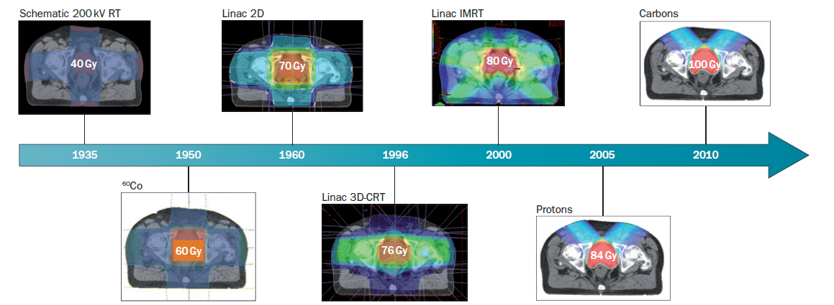
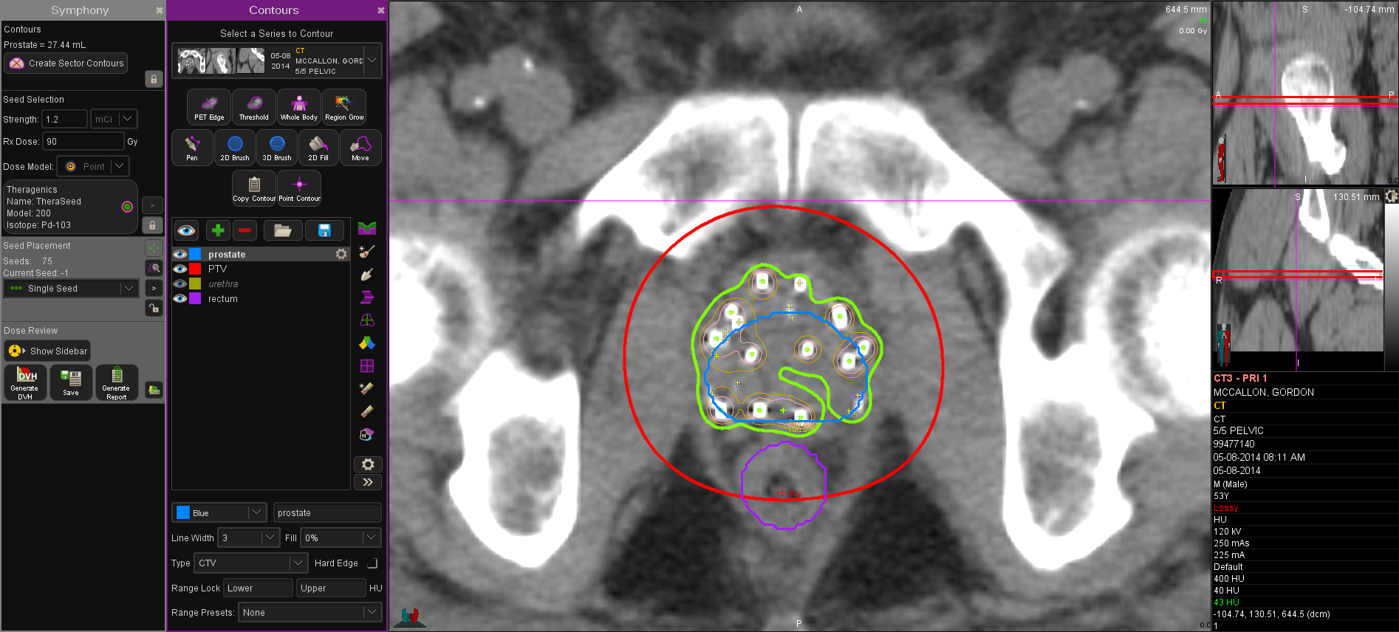
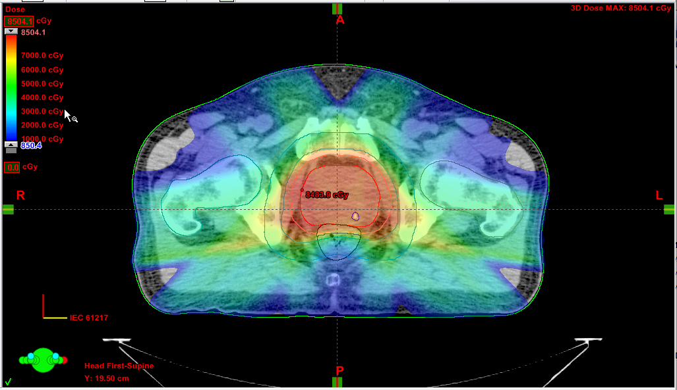
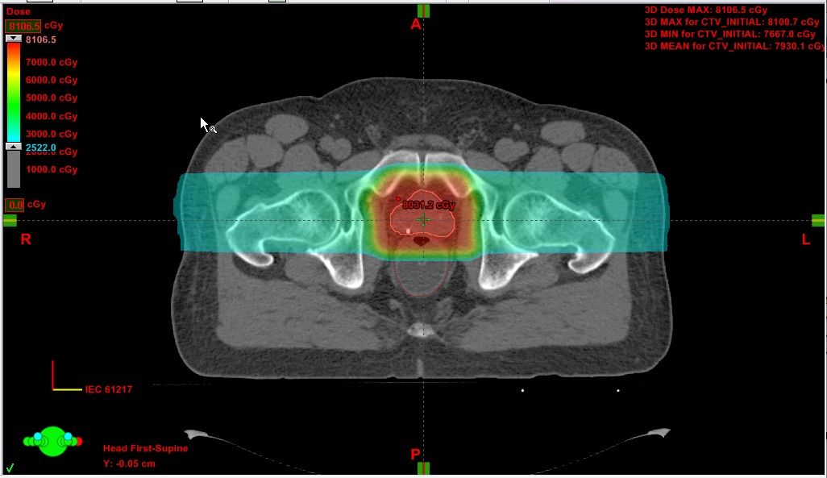
Prostatic Radiotherapy
100%
10%
40-50%
10% Isodose LDR
Brachy
Target Volume IMRT
Target Volume Protons

Slide 56
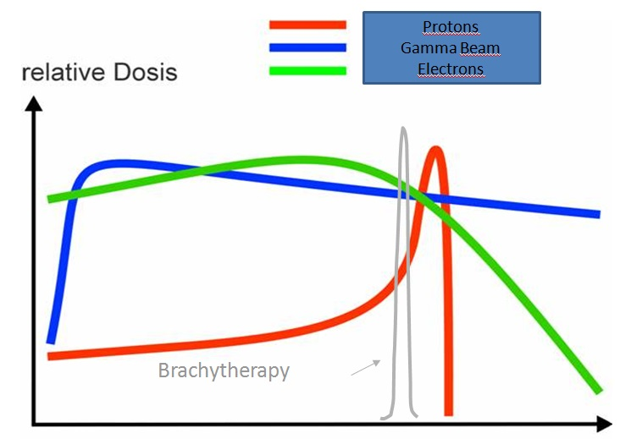

Slide 57
Potential of Brachytherapy:
Moving target is not a problem in BT
Moving target remains a problem in EBRT
Interstitial Brachytherapy for Prostate: CTV = PTV
No margin necessary . Much smaller PTV
CTV
ITV
Rectum

Slide 58
Why prostate brachytherapy?
No organ motion
No set-up errors
No CBCT or Tomo target identification uncertainties
No large low-dose normal tissues radiation volumes
No organ position tracking errors
No seeds migration, clumping, dose uncertainties over time, etc.
No temporary prostate edema
Accurate dosimetry and dose delivery
Radiobiological advantage
Cost, reimbursement
Courtesy: Michel Ghilezan, Michigan Healthcare Professionals, Farmongton Hills, MI

Slide 59
Brachytherapy – why?
Time (physician/patient)
Cost (patient/government/hospital)
Disease outcomes
Quality of Life
Patient’s satisfaction

Slide 60
easily money can decide on the treatment of patients and not the curability or quality of life after treatment.

Slide 61
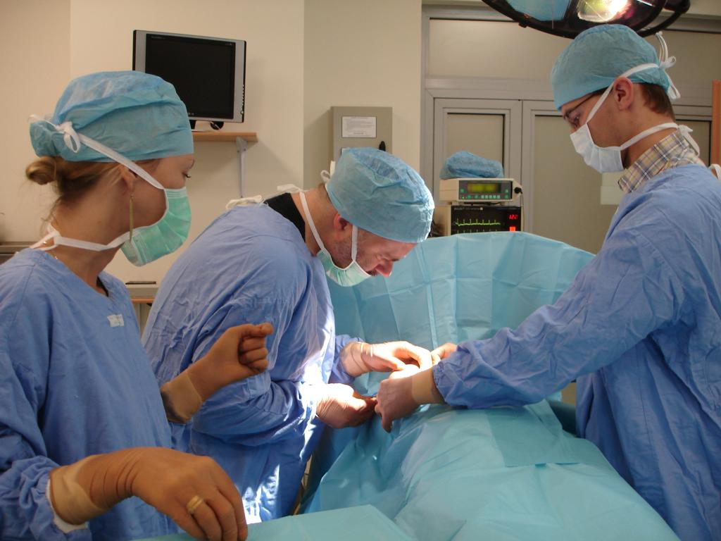
Thank you

